Slide 1


Welcome to .NET Conf!
Scott Hunter & Friends
Director Program Management, .NET
@coolcsh

Slide 2






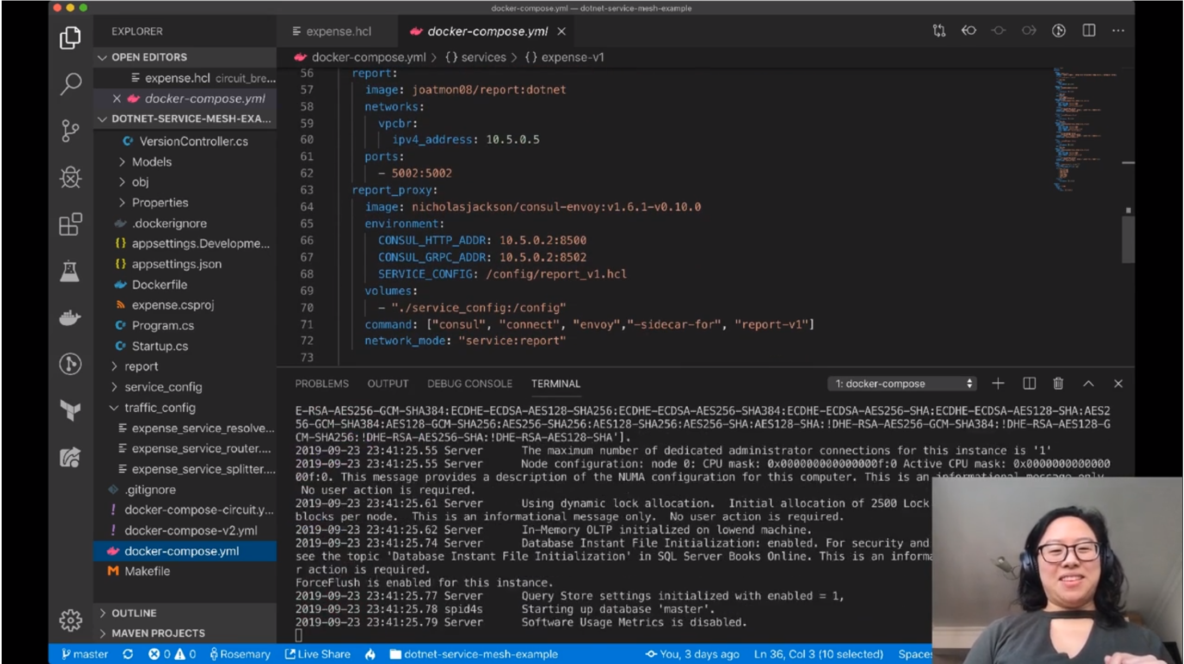



Happy 10th anniversary .NET Conf!
Thank you for joining us!
Notes:
Welcome to .NET Conf 2020! I’m really excited to be here on the 10th anniversary of .NET Conf and the .NET 5 launch! I’m Scott Hunter, Director of Program Management for .NET at Microsoft.
Congrats to everyone on a great release and 10 years of this virtual conference. It’s been an incredible journey to get where we are today and we couldn’t have done it without the .NET community. Here are just a few of the memories we’ve shared over the years from the first mvcConf with Scott Guthrie, then aspConf and then expanded and re-named to .NET Conf. It has evolved into the largest virtual .NET conference on the planet! We have 80 sessions for you this year, 100 wonderful speakers from all over the world, over 20 generous sponsors giving away a ton of prizes and best of all, we have .NET 5 available today!
Thank you for joining us!
<CLICK>

Slide 3
.NET 5 General Availability
Single file applications & smaller container images
Web and cloud investments
Windows desktop development enhancements
Windows ARM64 support
Continued performance improvements
New C# 9.0, F# 5.0 language features
dot.net/get-dotnet5
Notes:
I’m pleased to announce the general availability of .NET 5.
.NET 5 is the next version of .NET Core where we continue the journey of unifying the .NET platform. Our vision for one .NET is a unified set of libraries, tools/SDK and runtime. .NET 5 begins this with taking everything available in .NET Core and adding several cloud & web investments, such as smaller, faster single file apps that use less memory which are appropriate for microservices and containerized applications across operating systems. ASP.NET Blazor WebAssembly which allows you to write web UI in C# that runs completely in the browser, now uses the Core BCL (instead of Mono) further unifying the platform so developers can write code against the same base class libraries across all workloads. .NET 5 also embraces full Swagger support and makes it much easier to create testable, compatible, web APIs via OpenAPI. .NET 5 includes full design-time support for Windows Desktop development (WinForms and WPF) in Visual Studio, with first and third-party control support, Clickonce support, and side-by-side, single file deployment. There are also many runtime performance improvements, support for Windows ARM64, and new releases of languages C# 9.0 and F# 5.0.
And a HUGE thank you to all the contributors that have made an incredible improvements to the .NET 5 release. Hundreds of thousands of contributions, in fact. Open web browser to: https://dotnetthanks.azurewebsites.net/
Go get it and start building!
<CLICK>

Slide 4




.NET ecosystem momentum
2M .NET Core developers
#1 Most loved framework (2019 & 2020)
Top 30
Highest velocity OSS projects
in Visual Studio family
.NET Core
github.com/dotnet github.com/aspnet
Top 5
Language on GitHub
#1
TechEmpower Benchmarks
40%
New to .NET are students
C#
ASP.NET Core
www.dot.net download survey
insights.stackoverflow.com/survey/2019#most-loved-dreaded-and-wanted & insights.stackoverflow.com/survey/2020#most-loved-dreaded-and-wanted
github.com/cncf/velocity/
octoverse.github.com/
https://www.techempower.com/benchmarks/#section=data-r19&hw=ph&test=plaintext
Notes:
We are seeing significant growth in the .NET ecosystem and here’s a few data points I always like to share. Note that we have now reached over 2 million .NET developers using .NET Core. And .NET Core has been ranked #1 two years in a row as the most loved framework on StackOverflow developer survey. Cloud Native Computing Foundation (CNCF) tracks the highest velocity projects on all of GitHub which they measure by the rate at which pull requests and issues come in & how many are accepted, and both dotnet and aspnet projects are in the top 30. dotnet ranks in the top 10 in fact. Speaking of GitHub, C# is in the top 5 languages, an indicator of a healthy open source ecosystem. And I’m extremely proud of our work on performance. ASP.NET Core ranks #1 in those benchmarks – I’ll talk a little bit more about that in a minute. Lastly, we continue to see a large part of new users downloading .NET identifying as Students in our download survey, which gets thousands of responses a week.
<CLICK>

Slide 5
.NET adoption
WinForms & WPF on .NET Core
200K
Windows developers migrated to .NET Core
5 million
.NET developers
.NET Core
230K
First time .NET developers in September 2020
Monthly active developers in Visual Studio Family
.NET on Linux
2 million
Publishes per month to Linux from Visual Studio
Notes:
And our user base keeps growing!
There are over 5 million monthly active .NET developers in Visual Studio Family, which includes Visual Studio, Visual Studio Code, and Visual Studio for Mac. As I mentioned we’ve seen significant growth with .NET Core, our open source, cross-platform .NET, and it’s now surpassed 2 million active developers per month. We also are seeing a significant number of Windows desktop developers, 200 thousand, move to .NET Core from .NET Framework and we expect that to accelerate with .NET 5. Also super exciting is the number of first-time developers we’re seeing in use .NET. 230 thousand in September alone! And we continue to see about 2 million deployments per month to Linux from Visual Studio.
<CLICK>

Slide 6







Partner Tools and Controls for .NET 5
PARTNERS
Notes:
.NET has a rich ecosystem of partners building additional tools and controls to help you build beautiful, full-featured, applications faster.
We have many partners releasing support for Blazor, Winforms, and WPF on .NET Core in their tools and controls today as well. SyncFusion, Radzen, Progress Telerik, Infragistics, GrapeCity and DevExpress all have great controls for multiple app models for .NET 5.
THANK YOU!!
<CLICK>

Slide 7

OSS Partners for .NET 5 – Thank you!
OPEN SOURCE
Ant Design Blazor
ImageSharp
And many more…
bUnit
Live Reload Middleware for ASP.NET Core
Blazm
MatBlazor
Blazor Extensions
NuGet Package Explorer
Blazored
Oqtane
Blazorise
Reactive Extensions
BlazorStrap
Swashbuckle
Cake
Uno Platform
IdentityServer
Notes:
We also want to call out specific open source projects that had a big impact making the .NET 5 release awesome, as well as those projects that are built on .NET 5 today.
Of course, there are many more .NET open source projects under the .NET Foundation that make the .NET ecosystem a great place to be.
THANK YOU!!
<CLICK>

Slide 8
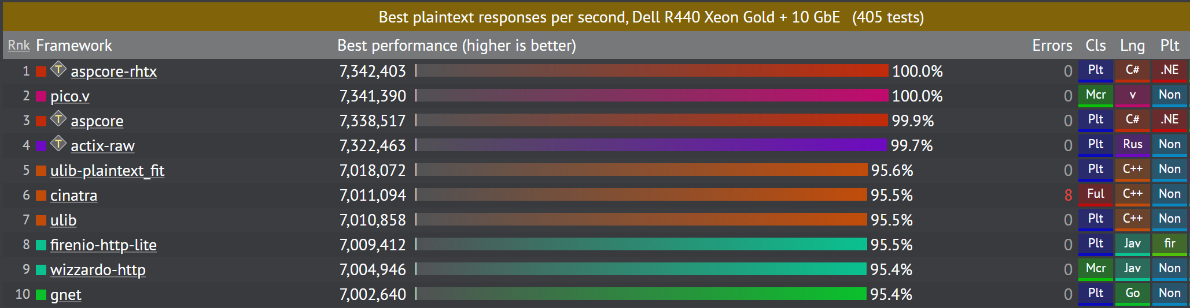
#1
TechEmpower Performance Benchmarks
Round 19
ASP.NET Core 3.1
https://www.techempower.com/benchmarks/#section=data-r19&hw=ph&test=plaintext&a=2
Notes:
Developers running critical services in production greatly depend on perf, both for a positive user experience and for cost and energy savings. That’s why we have always made performance a top priority in .NET Core.
According to the TechEmpower benchmarks, an independent, open source set of web performance benchmarks that measure dozens of languages and application frameworks, .NET has the fastest web framework on the planet. We are #1 on the Plaintext tests for Round 19 for .NET Core 3.1 on RHEL and #3 on Linux. Faster than C++, Java and Go.
<CLICK>

Slide 9
.NET 5 performance improvements
TechEmpower benchmarks round 20 predicted perf increases for .NET 5 over .NET Core 3.1
+38%
+42%
+20%
11,712,405 RPS
Plaintext
1,243,436 RPS
Json
417,818 RPS
Fortunes
Internal tests of .NET 5 performed on equivalent hardware as TechEmpower
Notes:
But .NET 5 will be even faster in Round 20…. And not just in Plaintext benchmarks. We mirror the exact same hardware as Techempower and monitor a dashboard constantly with results from all the tests they perform. We predict we will have significant performance in many other areas as well. We’re seeing our internal Json benchmarks now beating Netty (Java) as well as seeing over 400K requests per second on the Fortunes tests beating the best Go framework out there. Fortunes is the most real-world test there is, as it also measures database access.
These incredible results have been achieved because of a great collaboration between internal and external contributors.
<CLICK>

Slide 10
.NET 5 performance improvements
+30% socket performance improvement on Linux over .NET Core 3.1
JSON serialization performance improved +19% over .NET Core 3.1¹
Serialization of large collections & arrays improved 3x and are now zero-alloc
gRPC server performance exceeds Go, C++ and Java²
¹ All 104 JSON serialization benchmarks improved
² https://github.com/LesnyRumcajs/grpc_bench/wiki/2020-08-11-bench-results
Notes:
Take a look at some of the details here on how we continue our investments in performance all the way up and down the stack.
We’ve improved .NET 5 by 30% in socket performance on Linux over .NET Core 3.1. JSON serialization performance improved 19% over .NET Core 3.1. Serialization of large collections & arrays improved 3x and are now zero-alloc. gRPC server performance exceeds Go, C++ and Java as measured by a community run benchmark.
These are some incredible results and we will not stop here. We intend to continue the focus on performance in .NET moving forward as well.

Slide 11
Windows desktop development
Notes:
Let’s start digging into the new features of the release. First we start with our old friend, Windows desktop development with Winforms and WPF.
<CLICK>

Slide 12

Windows desktop apps on .NET 5
Complete development experience
Windows Forms & WPF designers
Visual Studio tooling
Clickonce Installer support
Third-party tools & controls
All the benefits of .NET 5
Self contained, single file EXEs
No need for .NET Framework on machine
Best performance
Modern controls like WebView2
Notes:
We know there are millions of Windows desktop applications out there written many years ago that are still business critical today that are being actively developed. We want to make sure these apps not only run on the latest .NET but can also be developed with the latest version of Visual Studio. That’s why we’ve worked to bring these workloads to .NET Core and now .NET 5. We already have over 200 thousand Windows developers moved from .NET Framework to .NET Core. With .NET 5, we’ve completed this work by bringing the full Visual Studio development experience to you, including third-party control and component vendors you may be using today, and clickonce installer support. By moving forward, these apps can get all the benefits of .NET 5 like self-contained, single file EXEs that don’t need the .NET Framework on the machine. You decide when you want to update, not the Windows OS. You can also use new, modern Windows 10 controls like WebView2, a modern browser control based on Microsoft Edge Chromium.
<CLICK>

Slide 13
Demo Modernizing Windows desktop apps
Scott Hanselman
Notes:
Let’s call in an old friend of mine to show you what I mean.

Slide 14
Thank you, Scott Guthrie!

Slide 15
Mobile development

Slide 16

Xamarin.Forms 5
Beautiful Design with Brushes, Shapes, and Paths
Control templating for native controls
Improved XAML experience in Visual Studio
Hot Reload 2.0
Develop iOS apps on Windows
Notes:
Xamarin.Forms 5 is coming out later this year with tons of features like the new APIs for brushes, shapes, and paths, letting you draw beautiful, custom, cross platform UIs for Android, iOS, and Windows.
There's a better than ever XAML experience with better intellisense and the new data binding diagnostics feature, and hot reload has been rebuilt from the ground up using the same tech that WPF and UWP use, giving you a fast, consistent experience no matter what you're developing for.
You can get started building cross-platform xamarin apps right now with just an iPhone and PC. <CLICK>

Slide 17


The Academy uses .NET, Visual Studio and Azure to build a multi-device streaming service for its members.
“Nobody understands .NET and SQL Server better than Microsoft, which, through Azure, gave us a robust set of managed services for migrating our legacy applications to the cloud.”
Bev Kite, Chief Information Officer, Academy of Motion Picture Arts and Sciences
Notes:
The Academy of Motion Picture Arts and Sciences used Xamarin and .NET to deliver a multi-device streaming service to their Academy members so they can watch nominated movies and vote. They have petabytes of data and need to deliver a robust, secure, solution that can run on any device. They were able to move their ASP.NET websites and middle-tier services to Azure App Service, SQL server to Azure SQL, and with Visual Studio and Azure DevOps they were able to modernize their applications, infrastructure, and development practices.
Let’s roll the video to hear their story.

Slide 18
Demo Mobile development with Xamarin
Maddy Leger

Slide 19
Visual Studio

Slide 20
Visual Studio 2019 16.8 GA and 16.9 Preview
.NET 5.0 included
.NET productivity enhancements
Intellicode team completions
New Git experience
Linux debugging
Improved XAML experience
GitHub Actions in Visual Studio
visualstudio.com/download aka.ms/vs-preview
Notes:
Productivity
Roslyn analyzers are now included in the .NET 5 SDK
IntelliSense completion for DateTime and TimeSpan
Inline parameter name hints
With Intellicode team completions, you can train a custom model on your C# codebase & get starred contextual completion suggestions for your own types.
New Git experience
Quickly access your Git shortcuts with a new Git menu
Easily execute your daily Git operations using the Git Changes window
Fluidly browse and manage your Git repository and stop worrying about merge conflicts
Linux Debugging
Debug managed Linux core dump directly in Visual Studio
.NET Core Debugging with WSL 2 using the Linux distro of your choice (Preview)
XAML experience
XAML Binding Failures diagnostic improvements
XAML Hot Reload supports UWP
GitHub Actions (Preview)
- Generate a GitHub Actions workflow from within Visual Studio for your ASP.NET Core apps

Slide 21
Demo Visual Studio Productivity
Kendra Havens

Slide 22
Web & cloud development

Slide 23

Full stack .NET web apps with Blazor in .NET 5
Supports Blazor Server & Blazor WebAssembly
Blazor WebAssembly enhancements
Now uses .NET 5 core framework libraries
3X faster than previous release
Supports server-side prerendering & lazy loading dependencies
Component virtualization
CSS & JavaScript isolation
New components
Growing ecosystem of third-party & OSS controls and tools
Notes:
.NET 5 includes support for building full stack .NET web apps with Blazor Server & Blazor WebAssembly. Blazor WebAssembly apps now use the core framework libraries from .NET 5 giving access to the entire .NET 5 API surface area. Runtime performance in Blazor WebAssembly is two to three times faster than in the previous release. Blazor WebAssembly also now supports server-side prerendering and lazy loading of app dependencies. Other new Blazor features includes support for component virtualization, CSS isolation, JavaScript isolation, capturing JavaScript object refs, new components for radio button groups and file inputs, setting the UI focus, and many other improvements for building client-side web apps with C# instead of JavaScript.

Slide 24


Startup company uses .NET, Visual Studio and Azure to provide an easy-to-use, affordable, and secure platform for end-of-life planning.
“With Blazor we’re able to develop both the front end and the back end with the same people. We’re able to get web applications written all in C#. It used to take us so much more code to write, it’s amazing.”
Ken Myers, Chief Technology Officer, The Postage
Notes:
The Postage is a Startup Company created around an application that could help people with end-of life planning. The founder and CEO had lost 3 family members in a very short time period and she wanted to create an affordable solution for people so they could spend time grieving, not chasing down the massive amounts of paperwork. They used .NET and Visual Studio to build a solution using ASP.NET, Blazor, Xamarin and Azure to rapidly create a secure solution. They were able to save time and personnel cost using .NET end-to-end because they could develop all the pieces using C# as well as reducing the amount of code they would have had to write.
Roll video

Slide 25
Demo Blazor on .NET 5
Daniel Roth

Slide 26

Cloud native investments
REST API’s
OpenAPI
API REPL
Client generation
Publish to Azure API Management (APIM)
gRPC contract-based API’s
Generate client & server from proto file
World class performance

Slide 27

Cloud native investments
Smaller, faster microservices
Smaller container images
Single file apps
Top-level C# programs
Project Tye tools
Build, debug and deploy microservices quickly
Cross-platform development with WSL and Linux
High-performance reverse proxy (YARP)

Slide 28
.NET 5 on Azure App Service
.NET 5 available today
.NET releases available on Day 1 going forward
aka.ms/app-service-early-access
Notes:
The ASP.NET and Azure App Service teams have worked tirelessly together throughout the .NET 5 timeline to make sure ASP.NET developers have access to the latest bits of the .NET 5 runtime on day zero. This means that, as soon as you can download .NET 5 and get started building apps with it, you can deploy those .NET 5 apps to App Service using Visual Studio and Visual Studio Code, and you'll have full support for deploying .NET 5 apps to App Service using GitHub Actions.
This day-zero availability of .NET 5 on App Service will be made possible by their new Early Access Runtime feature, which will enable not only .NET 5 apps, but every subsequent release of .NET from now on. This means no more waiting for the platform to support the runtime - it'll "just be there" as soon as the runtime is available.

Slide 29
Demo ASP.NET Web APIs on .NET 5
Brady Gaster

Slide 30

Project Tye in .NET 5
AKS
Build, debug and deploy microservices faster
Service discovery via configuration conventions
Service
Dependency
Add dependencies (Redis, SQL Server, etc.) without writing docker files
Name | Type | Source | Bindings
Frontend
Service
Dependency
Run and debug locally using containers and Kubernetes
Service
Dependency
Local dashboard for metrics, logging, debugging
Automatically dockerize and deploy to Azure Kubernetes Service
Notes:
Project Tye is all about making it easier and faster to build, debug, and deploy microservices.
Service discovery via configuration conventions
Runs multiple projects at the same time
Automatically handles connections to each other (ports/URLs)
Add dependencies (Redis, etc.) without writing docker files
Run & debug locally using containers and Kubernetes
Local dashboard for logs, metrics, etc.
Can dockerize and deploy your services to AKS

Slide 31
Demo Building microservices with Tye
David Fowler

Slide 32
Going forward

Slide 33
– .NET 5 to 6 "wave"
One .NET vision
.NET Framework
Single SDK, one BCL, unified toolchain
Cross-platform native UI
Cross-platform web UI
Cloud native investments
Continue improvements in speed, size, diagnostics, Azure services
.NET
.NET Core
Mono / Xamarin
.NET has the best of breed solutions for all modern workloads
Notes:
Animated slide
Our vision for one .NET is to simplify the platform and choices for .NET developers and provide a single stack that supports the best of breed solutions for all modern workloads.
Last year, we shared a broad vision of a singular .NET stack and ecosystem. We're happy to report that we now have the foundation in place to deliver on that vision, in .NET 6.0. And we’ll continue to unify the platform in the next wave of releases. We are working towards a single SDK, one set of base class libraries and a unified toolchain. You saw today that down payment today with Blazor in .NET 5 now uses the .NET core libraries instead of the mono libraries. We will deliver cross-platform native UI with .NET MAUI, cross-platform web UI, and many more cloud native enhancements. We will always continue to improve speed, size and fundamentals of the platform. And .NET will always run best on Azure.
You will continue to see a wave of innovation happening with multiple previews along the way on the journey to one .NET.

Slide 34
.NET Schedule
Nov 2020
.NET 5.0
Nov 2021
.NET 6.0
LTS
Nov 2022
.NET 7.0
Nov 2023
.NET 8.0
LTS
Nov 2024
.NET 9.0
.NET 5.0 released today!
Major releases every year in November
LTS for even numbered releases
Predictable schedule, minor releases as needed
Notes:
We’re super excited to release .NET 5.0 to you today. Going forward we will release a major version every November. Long Term Support releases will land evrey other year on even number releases. Predictable releases helps everyone, not only the businesses that use .NET but also the open source projects that are built upon .NET.

Slide 35
.NET 5 General Availability
Get it today!
dot.net/get-dotnet5
Also available in Visual Studio 2019 update 16.8
Notes:
In recap, we hope we inspired you to go get .NET 5 right now and start building your next project on .NET 5.

Slide 36

Thanks for joining!
Ask questions on Twitter using #dotNETConf
Notes:
Thanks for joining us! Have a great conference!

